Slide 1
Foundations of Cryptography IND-EAV, statistical distance, p.i., s.i., c.i., pseudorandom
LiangFeng Zhang
zhanglf@shanghaitech.edu.cn
SIST, ShanghaiTech, 2019F

Slide 2
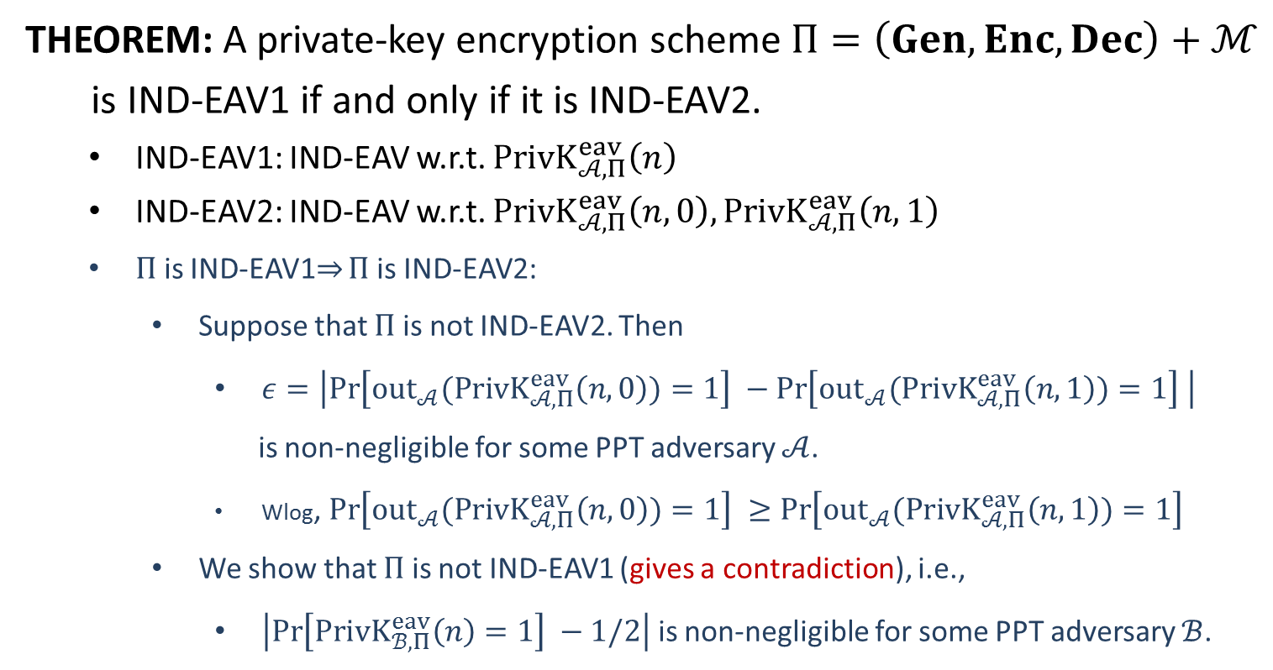
Equivalence
THEOREM: A private-key encryption scheme $Π=\left(Gen, Enc, Dec\right)+ℳ$
is IND-EAV1 if and only if it is IND-EAV2.
IND-EAV1: IND-EAV w.r.t. $PrivK_{𝒜, Π}^{eav}\left(n\right)$
IND-EAV2: IND-EAV w.r.t. $PrivK_{𝒜, Π}^{eav}\left(n,0\right),PrivK_{𝒜, Π}^{eav}\left(n,1\right)$
$Π$ is IND-EAV1$⇒$ $Π$ is IND-EAV2:
Suppose that $Π$ is not IND-EAV2. Then
$ε=\left|\operatorname{Pr}\left[{out}_{𝒜}(PrivK_{𝒜, Π}^{eav}\left(n,0\right))=1\right] −\operatorname{Pr}\left[{out}_{𝒜}(PrivK_{𝒜, Π}^{eav}\left(n,1\right))=1\right] \right|$
is non-negligible for some PPT adversary $𝒜$.
Wlog, $\operatorname{Pr}\left[{out}_{𝒜}(PrivK_{𝒜, Π}^{eav}\left(n,0\right))=1\right] ≥\operatorname{Pr}\left[{out}_{𝒜}(PrivK_{𝒜, Π}^{eav}\left(n,1\right))=1\right]$
We show that $Π$ is not IND-EAV1 (gives a contradiction), i.e.,
$\left|\operatorname{Pr}\left[PrivK_{ℬ, Π}^{eav}\left(n\right)=1\right] −1/2\right|$ is non-negligible for some PPT adversary $ℬ$.

Slide 3












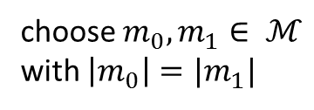


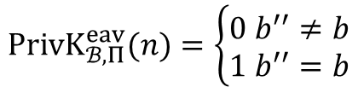

choose $m_{0}, m_{1}∈ ℳ$
with $\left|m_{0}\right|=|m_{1}|$
$$m_{0},m_{1}$$
$$m_{0},m_{1}$$
$$k←Gen\left(1^{n}\right)$$
$$b←\{0,1\}$$
$$c←Enc(k,m_{b})$$
$$c$$
$$c$$
$$b′$$
$$b^{′′}=\left\{\begin{aligned}0 b^{′}=1 \\ 1 b^{′}=0\end{aligned}\right.$$
$$b′′$$
$$PrivK_{ℬ, Π}^{eav}(n)=\left\{\begin{aligned}0 b^{′′}≠b \\ 1 b^{′′}=b\end{aligned}\right.$$
$$Challenger$$
$$𝓑$$
$$𝓐$$
$$PrivK_{𝓑 , Π}^{eav}\left(n\right)$$
$$PrivK_{𝒜, Π}^{eav}\left(n,b\right)$$

Slide 4
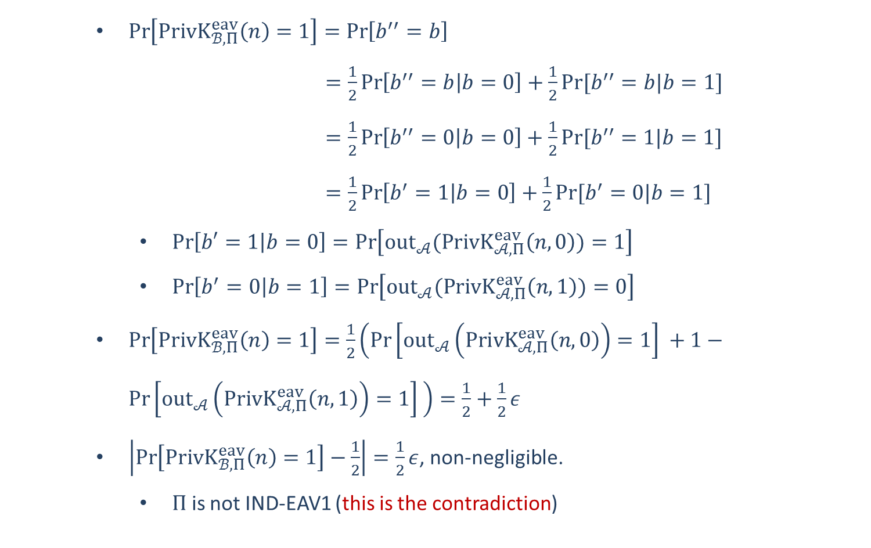
$\operatorname{Pr}\left[PrivK_{ℬ, Π}^{eav}\left(n\right)=1\right]=\operatorname{Pr}\left[b^{′′}=b\right]$
$=\frac{1}{2}\operatorname{Pr}\left[b^{′′}=b | b=0\right]+\frac{1}{2}Pr⁡[b^{′′}=b|b=1]$
$=\frac{1}{2}\operatorname{Pr}\left[b^{′′}=0 | b=0\right]+\frac{1}{2}Pr⁡[b^{′′}=1|b=1]$
$=\frac{1}{2}\operatorname{Pr}\left[b^{′}=1 | b=0\right]+\frac{1}{2}Pr⁡[b^{′}=0|b=1]$
$\operatorname{Pr}\left[b′=1 | b=0\right]=\operatorname{Pr}\left[{out}_{𝒜}(PrivK_{𝒜, Π}^{eav}\left(n,0\right))=1\right]$
$\operatorname{Pr}\left[b^{′}=0 | b=1\right]=\operatorname{Pr}\left[{out}_{𝒜}(PrivK_{𝒜, Π}^{eav}\left(n,1\right))=0\right]$
$\operatorname{Pr}\left[PrivK_{ℬ, Π}^{eav}\left(n\right)=1\right]=\frac{1}{2}\left(\operatorname{Pr}\left[{out}_{𝒜}\left(PrivK_{𝒜, Π}^{eav}\left(n,0\right)\right)=1\right] +1−\operatorname{Pr}\left[{out}_{𝒜}\left(PrivK_{𝒜, Π}^{eav}\left(n,1\right)\right)=1\right] \right)=\frac{1}{2}+\frac{1}{2}ε$
$\left|\operatorname{Pr}\left[PrivK_{ℬ, Π}^{eav}\left(n\right)=1\right]−\frac{1}{2}\right|=\frac{1}{2}ε$, non-negligible.
$Π$ is not IND-EAV1 (this is the contradiction)

Slide 5
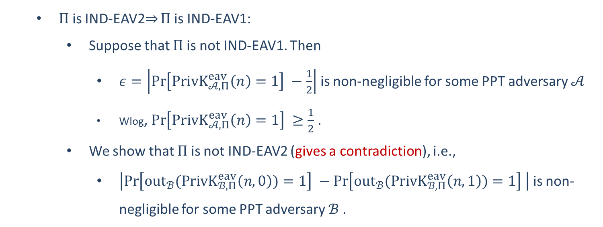
$Π$ is IND-EAV2$⇒$ $Π$ is IND-EAV1:
Suppose that $Π$ is not IND-EAV1. Then
$ε=\left|\operatorname{Pr}\left[PrivK_{𝒜, Π}^{eav}\left(n\right)=1\right] −\frac{1}{2}\right|$ is non-negligible for some PPT adversary $𝒜$
Wlog, $\operatorname{Pr}\left[PrivK_{𝒜, Π}^{eav}\left(n\right)=1\right] ≥\frac{1}{2}$ .
We show that $Π$ is not IND-EAV2 (gives a contradiction), i.e.,
$\left|\operatorname{Pr}\left[{out}_{ℬ}(PrivK_{ℬ, Π}^{eav}\left(n,0\right))=1\right] −\operatorname{Pr}\left[{out}_{ℬ}(PrivK_{ℬ, Π}^{eav}\left(n,1\right))=1\right] \right|$ is non-negligible for some PPT adversary $ℬ$.

Slide 6
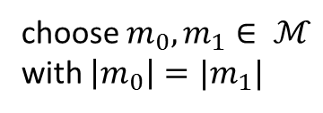













choose $m_{0}, m_{1}∈ ℳ$
with $\left|m_{0}\right|=|m_{1}|$
$$m_{0},m_{1}$$
$$m_{0},m_{1}$$
$$k←Gen\left(1^{n}\right)$$
$$c←Enc(k,m_{b})$$
$$c$$
$$c$$
$$b′$$
$$b′$$
$$Challenger$$
$$𝓑$$
$$𝓐$$
$$PrivK_{𝓑 , Π}^{eav}\left(n,b\right)$$
$$PrivK_{𝒜, Π}^{eav}\left(n\right)$$

Slide 7
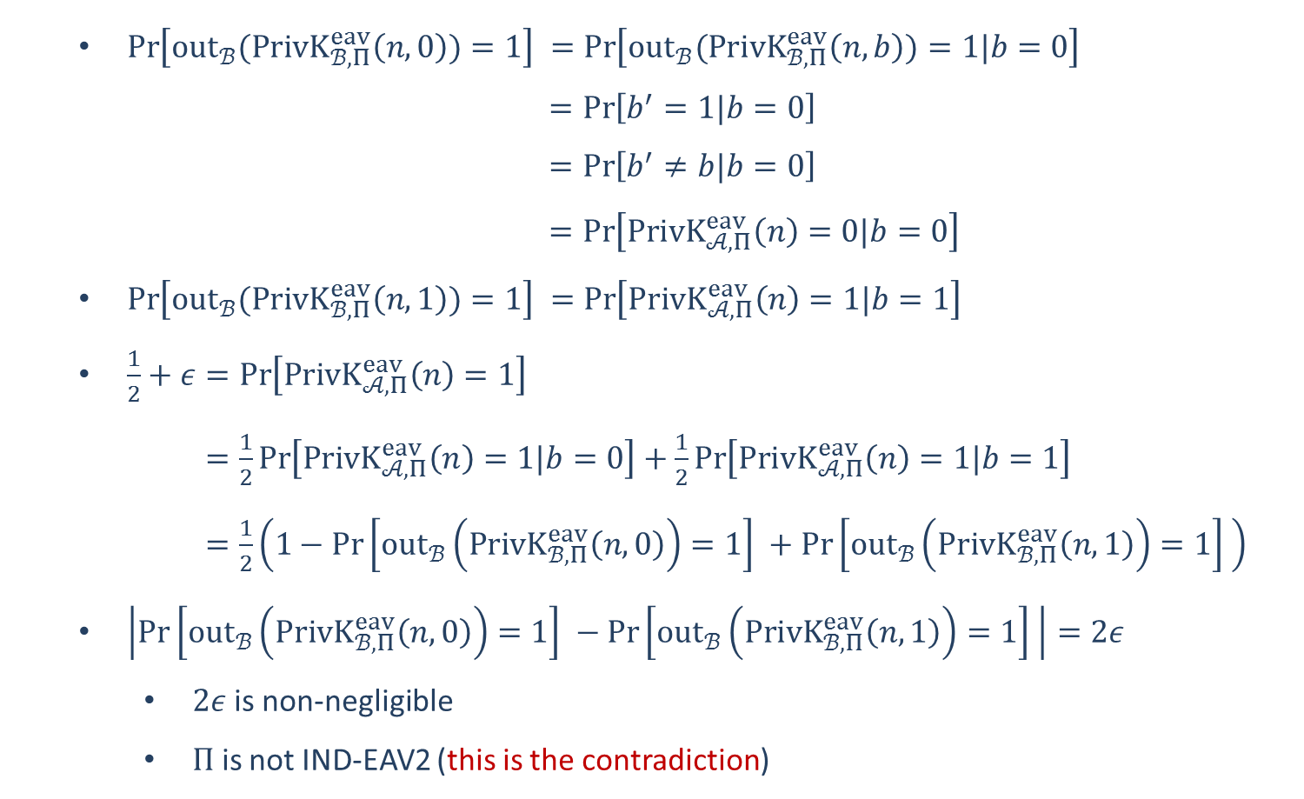
$\operatorname{Pr}\left[{out}_{ℬ}(PrivK_{ℬ, Π}^{eav}\left(n,0\right))=1\right] =\operatorname{Pr}\left[{out}_{ℬ}(PrivK_{ℬ, Π}^{eav}\left(n,b\right))=1|b=0\right]$
$=\operatorname{Pr}\left[b^{′}=1|b=0\right]$
$=\operatorname{Pr}\left[b^{′}≠b|b=0\right]$
$=\operatorname{Pr}\left[PrivK_{𝒜, Π}^{eav}\left(n\right)=0|b=0\right]$
$\operatorname{Pr}\left[{out}_{ℬ}(PrivK_{ℬ, Π}^{eav}\left(n,1\right))=1\right] =\operatorname{Pr}\left[PrivK_{𝒜, Π}^{eav}\left(n\right)=1|b=1\right]$
$\frac{1}{2}+ε=\operatorname{Pr}\left[PrivK_{𝒜, Π}^{eav}\left(n\right)=1\right]$
$=\frac{1}{2}\operatorname{Pr}\left[PrivK_{𝒜, Π}^{eav}\left(n\right)=1|b=0\right]+\frac{1}{2}\operatorname{Pr}\left[PrivK_{𝒜, Π}^{eav}\left(n\right)=1|b=1\right]$
$=\frac{1}{2}\left(1−\operatorname{Pr}\left[{out}_{ℬ}\left(PrivK_{ℬ, Π}^{eav}\left(n,0\right)\right)=1\right] +\operatorname{Pr}\left[{out}_{ℬ}\left(PrivK_{ℬ, Π}^{eav}\left(n,1\right)\right)=1\right] \right)$
$\left|\operatorname{Pr}\left[{out}_{ℬ}\left(PrivK_{ℬ, Π}^{eav}\left(n,0\right)\right)=1\right] −\operatorname{Pr}\left[{out}_{ℬ}\left(PrivK_{ℬ, Π}^{eav}\left(n,1\right)\right)=1\right] \right|=2ε$
$2ε$is non-negligible
$Π$ is not IND-EAV2 (this is the contradiction)

Slide 8

















OTP is IND-EAV
$$m_{0},m_{1}$$
choose $m_{0}, m_{1}∈{\left\{0,1\right\}}^{n}$
$$k←{\left\{0,1\right\}}^{n}$$
$$c←k⊕m_{0}$$
$$Adversary 𝒜$$
$$Challenger$$
$$c$$
$$b^{′}$$
$$m_{0},m_{1}$$
choose $m_{0}, m_{1}∈{\left\{0,1\right\}}^{n}$
$$k←{\left\{0,1\right\}}^{n}$$
$$Challenger$$
$$c←k⊕m_{1}$$
$$Adversary 𝒜$$
$$c$$
$$b^{′}$$
$$k⊕m_{0}≡k⊕m_{1}$$
$$\operatorname{Pr}\left[{out}_{𝒜}(PrivK_{𝒜, OTP}^{eav}\left(n,0\right))=1\right] =\operatorname{Pr}\left[{out}_{𝒜}(PrivK_{𝒜, OTP}^{eav}\left(n,1\right))=1\right]$$

Slide 9
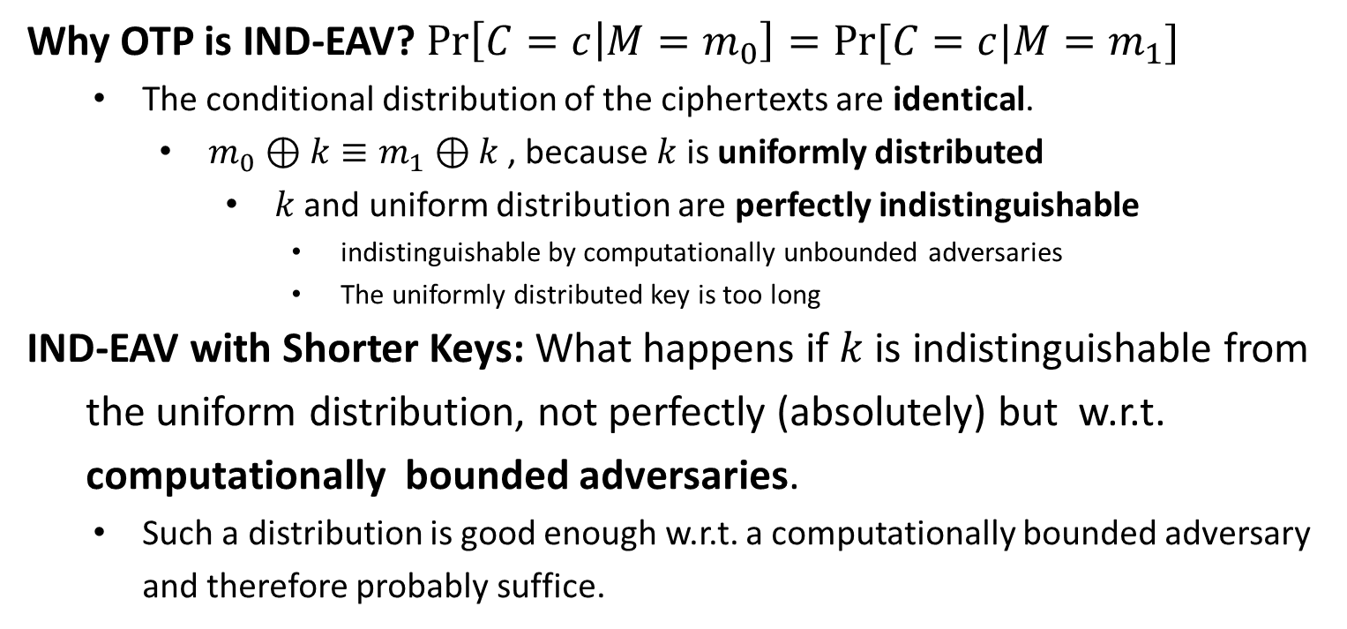
OTP is IND-EAV
Why OTP is IND-EAV? $\operatorname{Pr}\left[C=c | M=m_{0}\right]=Pr⁡[C=c|M=m_{1}]$
The conditional distribution of the ciphertexts are identical.
$m_{0}⊕k≡m_{1}⊕k$ , because $k$ is uniformly distributed
$k$ and uniform distribution are perfectly indistinguishable
indistinguishable by computationally unbounded adversaries
The uniformly distributed key is too long
IND-EAV with Shorter Keys: What happens if $k$ is indistinguishable from
the uniform distribution, not perfectly (absolutely) but w.r.t.
computationally bounded adversaries.
Such a distribution is good enough w.r.t. a computationally bounded adversary and therefore probably suffice.

Slide 11
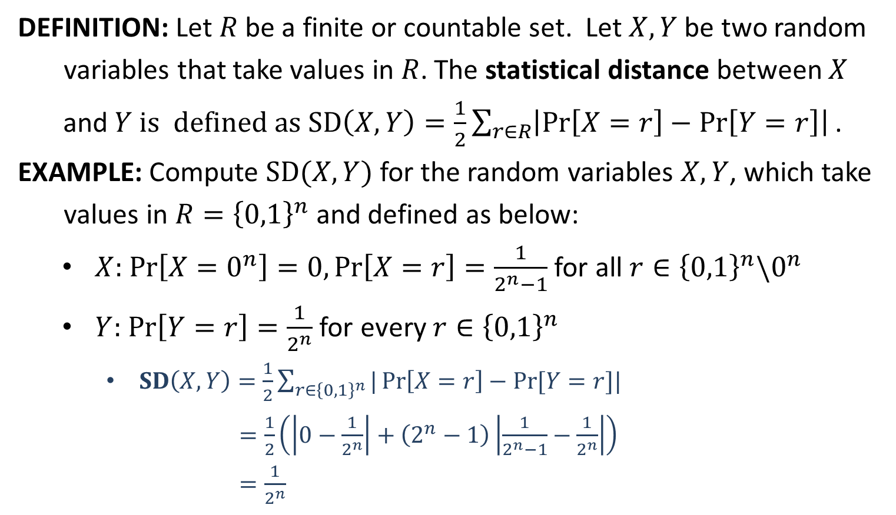
Statistical Distance
DEFINITION: Let $R$ be a finite or countable set. Let $X,Y$ be two random
variables that take values in $R$. The statistical distance between $X$
and $Y$ is defined as $SD\left(X,Y\right)=\frac{1}{2}\sum_{r∈R}{\left|\operatorname{Pr}\left[X=r\right]−\operatorname{Pr}\left[Y=r\right]\right| }$.
EXAMPLE: Compute $SD(X,Y)$ for the random variables $X,Y$, which take
values in $R={\left\{0,1\right\}}^{n}$ and defined as below:
$X:$ $\operatorname{Pr}\left[X=0^{n}\right]=0,\operatorname{Pr}\left[X=r\right]=\frac{1}{2^{n}−1}$ for all $r∈{\left\{0,1\right\}}^{n}\backslash 0^{n}$
$Y:$ $\operatorname{Pr}\left[Y=r\right]=\frac{1}{2^{n}}$ for every $r∈{\left\{0,1\right\}}^{n}$
$SD\left(X,Y\right)=\frac{1}{2}\sum_{r∈{\left\{0,1\right\}}^{n}}{|\operatorname{Pr}\left[X=r\right]−Pr⁡[Y=r]|}$
$=\frac{1}{2}\left(\left|0−\frac{1}{2^{n}}\right|+\left(2^{n}−1\right)\left|\frac{1}{2^{n}−1}−\frac{1}{2^{n}}\right|\right)$
$=\frac{1}{2^{n}}$

Slide 12
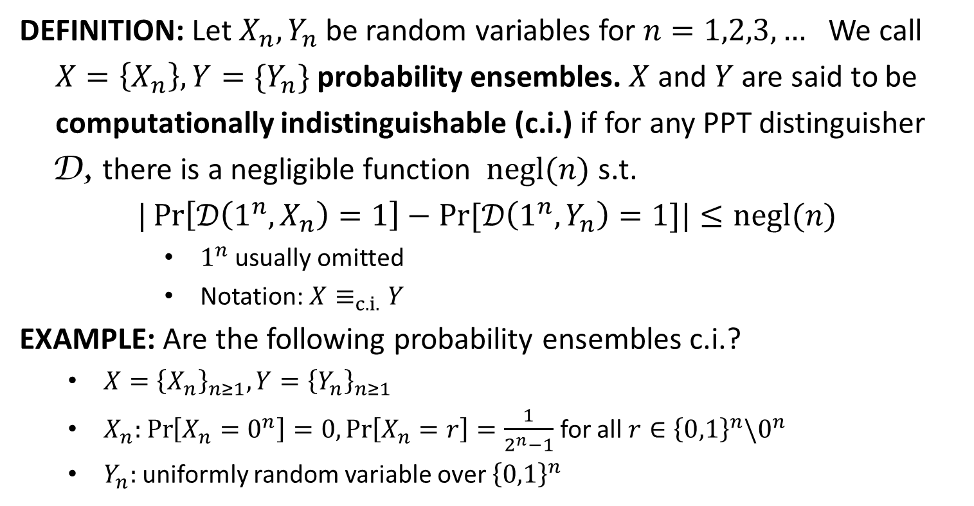
Computational Indistinguishability
DEFINITION: Let $X_{n},Y_{n}$ be random variables for $n=1,2,3,…$ We call
$X=\left\{X_{n}\right\}, Y=\{Y_{n}\}$ probability ensembles. $X$ and $Y$ are said to be
computationally indistinguishable (c.i.) if for any PPT distinguisher
D, there is a negligible function $negl(n)$ s.t.
$|\operatorname{Pr}\left[𝒟\left(1^{n},X_{n}\right)=1\right]−Pr⁡[𝒟\left(1^{n},Y_{n}\right)=1]|≤negl(n)$
$1^{n}$ usually omitted
Notation: $X≡_{c.i.}Y$
EXAMPLE: Are the following probability ensembles c.i.?
$X={\left\{X_{n}\right\}}_{n≥1}, Y={\left\{Y_{n}\right\}}_{n≥1}$
$X_{n}:$ $\operatorname{Pr}\left[X_{n}=0^{n}\right]=0,\operatorname{Pr}\left[X_{n}=r\right]=\frac{1}{2^{n}−1}$ for all $r∈{\left\{0,1\right\}}^{n}\backslash 0^{n}$
$Y_{n}:$ uniformly random variable over ${\left\{0,1\right\}}^{n}$

Slide 13
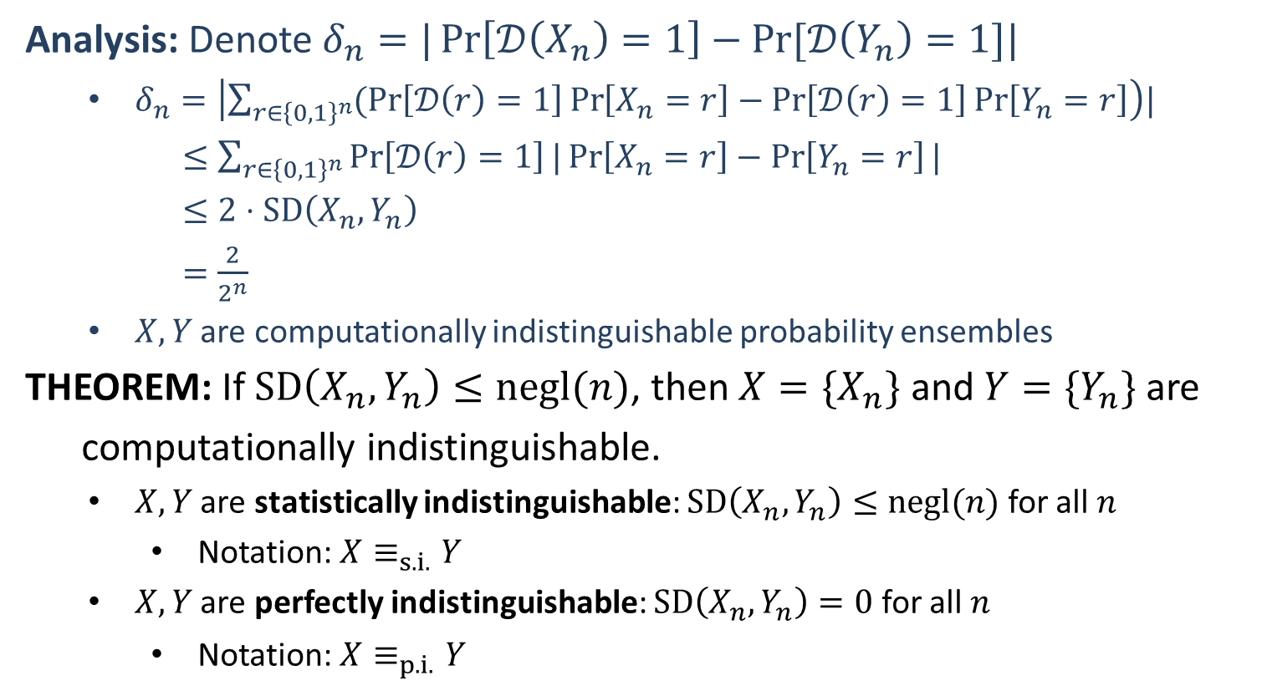
Computational Indistinguishability
Analysis: Denote $δ_{n}=|\operatorname{Pr}\left[𝒟\left(X_{n}\right)=1\right]−Pr⁡[𝒟\left(Y_{n}\right)=1]|$
$δ_{n}=\left|\sum_{r∈{\left\{0,1\right\}}^{n}}{(\operatorname{Pr}\left[𝒟\left(r\right)=1\right]}\operatorname{Pr}\left[X_{n}=r\right]−\operatorname{Pr}\left[𝒟\left(r\right)=1\right]\operatorname{Pr}\left[Y_{n}=r\right]\right)|$
$≤\sum_{r∈{\left\{0,1\right\}}^{n}}{\operatorname{Pr}\left[𝒟\left(r\right)=1\right]}|\operatorname{Pr}\left[X_{n}=r\right]−\operatorname{Pr}\left[Y_{n}=r\right]|$
$≤2⋅SD\left(X_{n},Y_{n}\right)$
$=\frac{2}{2^{n}}$
$X, Y$ are computationally indistinguishable probability ensembles
THEOREM: If $SD\left(X_{n},Y_{n}\right)≤negl(n)$, then $X=\{X_{n}\}$ and $Y=\{Y_{n}\}$ are
computationally indistinguishable.
$X,Y$ are statistically indistinguishable: $SD\left(X_{n},Y_{n}\right)≤negl(n)$ for all $n$
Notation: $X≡_{s.i.}Y$
$X,Y$ are perfectly indistinguishable: $SD\left(X_{n},Y_{n}\right)=0$ for all $n$
Notation: $X≡_{p.i.}Y$

Slide 14
Computational Indistinguishability
THEOREM: $X≡_{p.i.}Y⇒X≡_{s.i.}Y⇒ X≡_{c.i.}Y.$
$SD\left(X_{n},Y_{n}\right)=0⇒SD\left(X_{n},Y_{n}\right)≤negl\left(n\right)⇒X≡_{c.i.}Y$
We say that $p.i. ⇒s.i. ⇒c.i.$ (from strong to weak)
THEOREM: $X≡_{a}X$ for $a∈\{p.i., s.i., c.i.\}$
THEOREM: $X≡_{a}Y⇒Y≡_{a}X$ for $a∈\{p.i., s.i., c.i.\}$
$SD\left(X_{n},Y_{n}\right)=0⇒SD\left(Y_{n},X_{n}\right)=0$
$SD\left(X_{n},Y_{n}\right)≤negl\left(n\right)⇒SD\left(Y_{n},X_{n}\right)≤negl\left(n\right)$
$|\operatorname{Pr}\left[𝒟\left(X_{n}\right)=1\right]−Pr⁡[𝒟\left(Y_{n}\right)=1]|≤negl\left(n\right)⇒|\operatorname{Pr}\left[𝒟\left(Y_{n}\right)=1\right]−Pr⁡[𝒟\left(X_{n}\right)=1]|≤negl\left(n\right)$
THEOREM: $X≡_{a}Y, Y≡_{b}Z⇒X≡_{weak(a,b)}Z$, where
$weak\left(a,b\right)=\left\{\begin{aligned}a if b⇒a \\ b if a⇒b\end{aligned}\right.$ for all $a,b∈\{p.i., s.i., c.i.\}$.

Slide 16
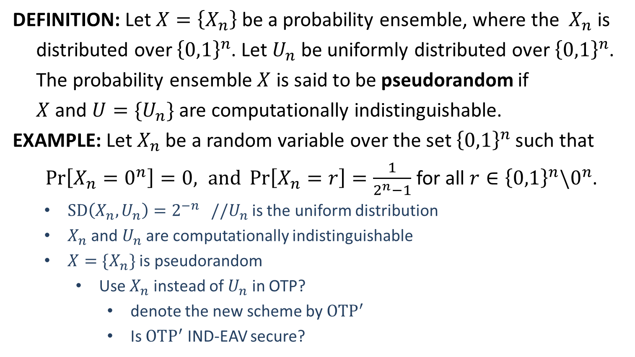
Pseudorandomness
DEFINITION: Let $X=\left\{X_{n}\right\}$be a probability ensemble, where the $X_{n}$ is
distributed over ${\left\{0,1\right\}}^{n}$. Let $U_{n}$ be uniformly distributed over ${\left\{0,1\right\}}^{n}$.
The probability ensemble $X$ is said to be pseudorandom if
$X$ and $U=\{U_{n}\}$ are computationally indistinguishable.
EXAMPLE: Let $X_{n}$ be a random variable over the set ${\left\{0,1\right\}}^{n}$ such that
$\operatorname{Pr}\left[X_{n}=0^{n}\right]=0, and \operatorname{Pr}\left[X_{n}=r\right]=\frac{1}{2^{n}−1}$ for all $r∈{\left\{0,1\right\}}^{n}\backslash 0^{n}$.
$SD\left(X_{n},U_{n}\right)=2^{−n}$ //$U_{n}$ is the uniform distribution
$X_{n}$ and $U_{n}$ are computationally indistinguishable
$X=\{X_{n}\}$ is pseudorandom
Use $X_{n}$ instead of $U_{n}$ in OTP?
denote the new scheme by $OTP^{′}$
Is $OTP^{′}$ IND-EAV secure?

Slide 17
IND-EAV from Pseudorandomness
$$m_{0},m_{1}$$
$$m_{0},m_{1}$$
$$k←X_{n}$$
$$k←{\left\{0,1\right\}}^{n}$$
$$c_{1}=k⊕m_{0}$$
$$c_{1}$$
$${c_{1}≡}_{s.i.}c_{2}$$
$$c_{2}=k⊕m_{0}$$
$$c_{2}$$
$$b^{′}$$
$$b^{′}$$
challenger
$$𝒜$$
challenger
$$𝒜$$
$${c_{1}≡}_{s.i.}c_{4}$$
$$c_{2}≡_{p.i.}c_{3}$$
$$m_{0},m_{1}$$
$$m_{0},m_{1}$$
$$k←X_{n}$$
$$k←{\left\{0,1\right\}}^{n}$$
$$c_{4}=k⊕m_{1}$$
$$c_{4}$$
$${c_{4}≡}_{s.i.}c_{3}$$
$$c_{3}=k⊕m_{1}$$
$$c_{3}$$
$$b^{′}$$
$$b^{′}$$
challenger
$$𝒜$$
challenger
$$𝒜$$
IND-EAV secure
$\left|k\right|=\log_{2}{(2^{n}−1)}<n$ bits
$$PrivK_{𝒜, OTP^{′}}^{eav}\left(n,b\right)$$
$$PrivK_{𝒜, OTP}^{eav}\left(n,b\right)$$

